Slide 1




node-voltage analysis

Slide 2
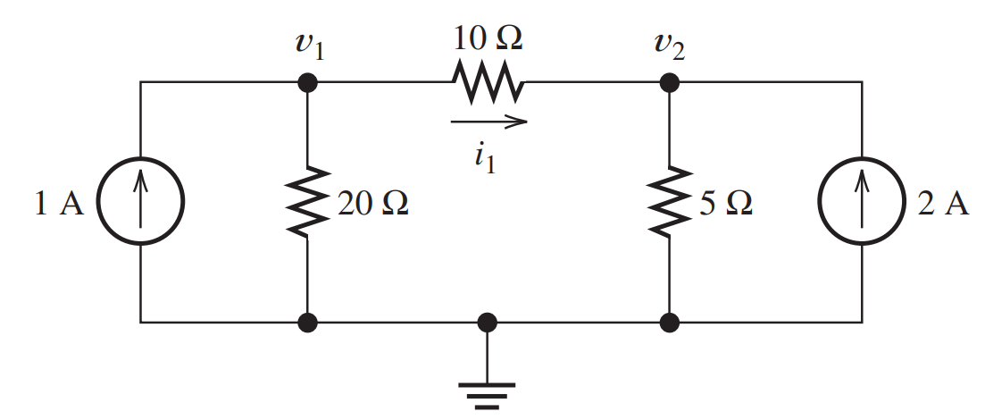
Example 1
Write equations and solve for the node voltages shown in Figure. Then, find the value of i1.

Slide 3
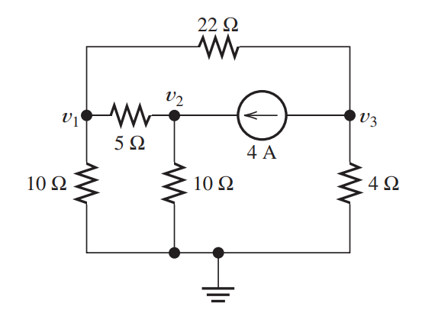
Example 2
Solve for the node voltages shown in Figure.
What are the new values of the node voltages after the direction of the current source is reversed?
How are the values related?

Slide 4
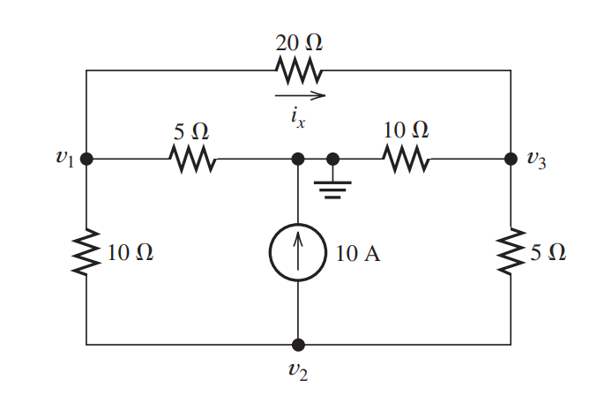
Example 3
Find Node Voltages and then find ix

Slide 5
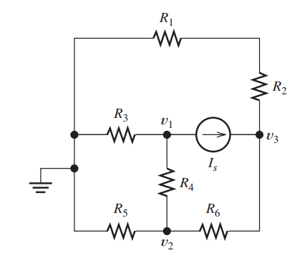
Assignment 1
Given R1 = 20, R2 = 8, R3 = 20, R4 = 12, R5 = 10, R6 = 5, and Is = 4 A.
Solve for the node voltages shown in Figure

Slide 6
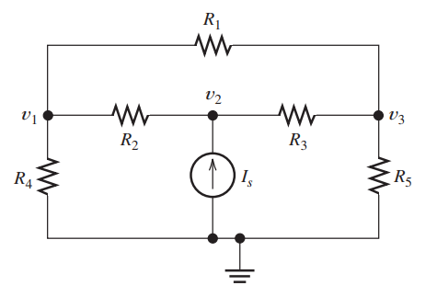
Assignment 2
Given R1 = 4, R2 = 5, R3 = 8, R4 = 6, R5 = 8 and Is = 4 A,
Solve for the node voltages shown in Figure

Slide 7
Mesh-Current Analysis

Slide 8
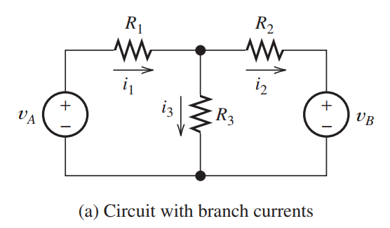
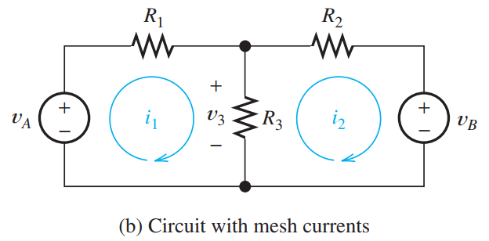
Branch & mesh currents

Slide 9
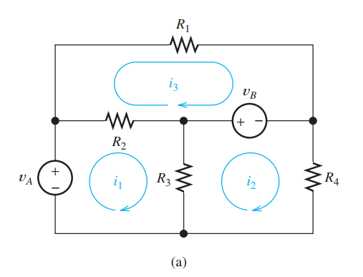
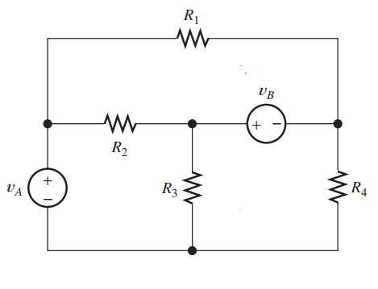
Choosing the Mesh Currents

Slide 10

Branch Currents
Current in R1: i3
Current in R2: (i1-i3) or (i3-i1)
Current in R3: (i1-i2) or (i2-i1)
Current in R4: i2

Slide 11
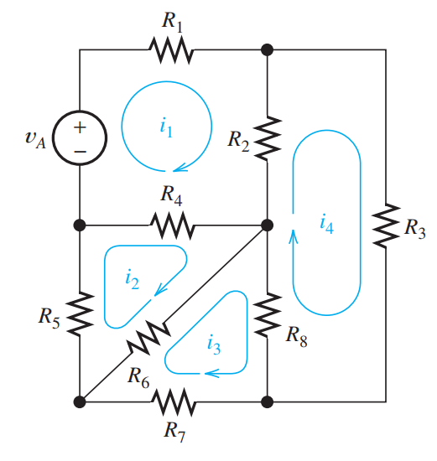
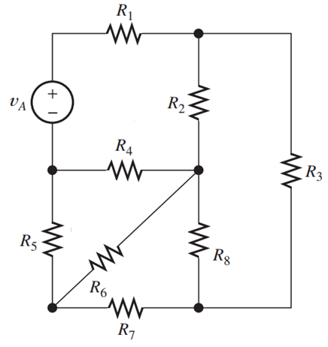
Choosing the Mesh Currents

Slide 12
Branch Currents
Current in R1: i1
Current in R2: (i1-i4) or (i4-i1)
Current in R3: i4
Current in R4: (i1-i2) or (i2-i1)
Current in R5: i2
Current in R6: (i2-i3) or (i3-i2)
Current in R7: i3
Current in R8: (i3-i4) or (i4-i3)

Slide 13
Procedure
Step 1: To select the mesh currents to flow clockwise.
Step 2: Then, we write a KVL equation for each mesh, going around the meshes clockwise.
Note: As usual, we add a voltage if its positive reference is encountered first in traveling around the mesh, and we subtract the voltage if the negative reference is encountered first.

Slide 14
Mesh-Current Equations using KVl
Loop 1:
-va + (i1-i3)R2 + (i1-i2)R3 = 0
Loop 2:
R3(i2-i1) + vb + R4(i2) = 0
Loop 3:
R2(i3-i1) + R4(i3) – vb = 0

